Slide 1
Weather Forecasting System
Robert Niesen
Emmanuel Raguay
Lalitha Vedula
Dilusha Harischandra
Ulloa Efren
6/26/2014
Notes:
This template can be used as a starter file for presenting training materials in a group setting.
Sections
Right-click on a slide to add sections. Sections can help to organize your slides or facilitate collaboration between multiple authors.
Notes
Use the Notes section for delivery notes or to provide additional details for the audience. View these notes in Presentation View during your presentation.
Keep in mind the font size (important for accessibility, visibility, videotaping, and online production)
Coordinated colors
Pay particular attention to the graphs, charts, and text boxes.
Consider that attendees will print in black and white or grayscale. Run a test print to make sure your colors work when printed in pure black and white and grayscale.
Graphics, tables, and graphs
Keep it simple: If possible, use consistent, non-distracting styles and colors.
Label all graphs and tables.

Slide 2
Background & Need
Need to predict harsh weather conditions - particularly during the brutal, bitterly cold winters we experience here in Chicago
Need for the students to anticipate large amounts of snowfall that may substantially delay their commutes to campus.
A weather forecast system to gauge everyday temperatures, with historical and forecasted weather information including adverse weather alerts
A forecasting system that functions primarily through the use of formulas
Allows students to view weather forecasts for up to 3 days or less
The system will provide this service to students and strive to do so as accurately and reliably as possible
The system will be a perfect addition to the software available to students at Northeastern Illinois University because as a strictly commuter school, NEIU students come from different parts of the city and have vested interests in any adverse weather conditions that may delay or otherwise affect their commutes to school.
Recommendation
Description
Benefits
Notes:
Give a brief overview of the presentation. Describe the major focus of the presentation and why it is important.
Introduce each of the major topics.
To provide a road map for the audience, you can repeat this Overview slide throughout the presentation, highlighting the particular topic you will discuss next.

Slide 3
Glossary of terms
TERMS | DEFINITIONS
Air Pressure | Cumulative force exerted on any surface by the molecules composing of air.
CAPE | Convective available potential energy. Amount of energy a parcel of air would have if lifted a certain distance vertically through the atmosphere. Larger the value over 0, the more potential energy there is available and storms will build vertically quickly. This is also used to assess the potential for large hail, amount of lightning in a storm, and potential for pockets of very heavy rain.
CIN | Convective Inhibition. Region where a parcel of air if raised will sink back down again. This is also known as the capping layer and inhibits storms from forming. In order for storms to form, this layer must be broken. Daytime heating usually erodes this cap. Larger the value, larger the cap on the atmosphere.
Dew Point | Temperature to which air must be cooled at constant pressure to achieve saturation. Has to be above 32 °F.
Dew Point Depression | Difference between the temperature and dewpoint of a sample of air. Lower values means the relative humidity is going to be higher.
Freezing Level | Level in the atmosphere that represents the freezing point of water at 0 °C.
Instability | A condition in which air will rise freely on its own due to positive buoyancy. Air in the lower atmosphere will lift until it’s less dense than the surrounding air. Once it’s less dense, it will rise on its own. The condition of the atmosphere when thunderstorms and severe weather can occur.
K Index | Index to assess convective potential. Values above 15 equates to a better convective potential. Higher the values, better chance of seeing storms if they do form.

Slide 4
Glossary of terms
TERM | DEFINITION
Lifted Index | Index used to assess instability in the lower part of the atmosphere. Values above 0 indicate a stable atmosphere. A stable atmosphere is not conductive for producing storms. Values below 0 equates to larger amounts of instability.
MB | Stands for millibars. Used to represent atmospheric air pressure. Sea level pressure is defined as 1000 mb. Going up in the atmosphere, the pressure levels decreases. The main levels Meteorologist look at for forecasting are 850, 700, 500, and 300 for various parameters such as wind, moisture and temperature to aid in forecasting the weather at the surface.
Relative Humidity | Is how close an air sample is to saturation at a specific temperature.
Saturation | The atmosphere is considered saturated when the humidity is 100%. This means the air cannot hold anymore water.
Saturation Vapor | Point where vapor pressure is saturated.
Showalter Index | Index used to assess 850 mb air parcel instability. A negative value indicates an environment where convection can occur. More negative the value, more unstable the environment is.
Sweat Index | Determines the likeliness of severe weather and tornadoes. Variables over 150 equates to a better chance of seeing severe weather if storms do form.
Total Totals | A parameter used to assess storm strength. Values above 44 equates to thunderstorms. The larger the value, the stronger the storms if they do form.
Vapor Pressure | Portion of the total air pressure exerted by the water vapor in a sample of air.
Water Vapor | Is the gas phase of water. Produced from the evaporation of liquid water and aids in the formation of clouds.

Slide 5
Requirements
User Requirements Definition
Our application is a system that will strive to accurately and reliably predict the weather conditions in Chicago and the surrounding suburbs for up to 3 days. It will also let students specify a period of up to 3 days are specified.
Functional Requirements
The system will allow users to enter a period of up to 3 days and will deliver weather predictions for the specified amount of time.
The system shall display the following weather parameters:
Temperature in Celsius and Fahrenheit
Real feel in Celsius and Fahrenheit
Humidity
Precipitation
Wind
The system shall default with current location weather information upon start up
The system shall provide the user with an option to click on any desired location for weather prediction
The system shall support severe weather alerts and advisories
The system shall support historical weather information up to 30 days with actual, average and record min and max temperatures This is for if there is time. May be tough to download data for another city
Non-functional Requirements
The system should be made available at all times, be platform independent, and functional on most connection speeds.
The system is coded in such a way that optimizes maintainability and safety

Slide 6
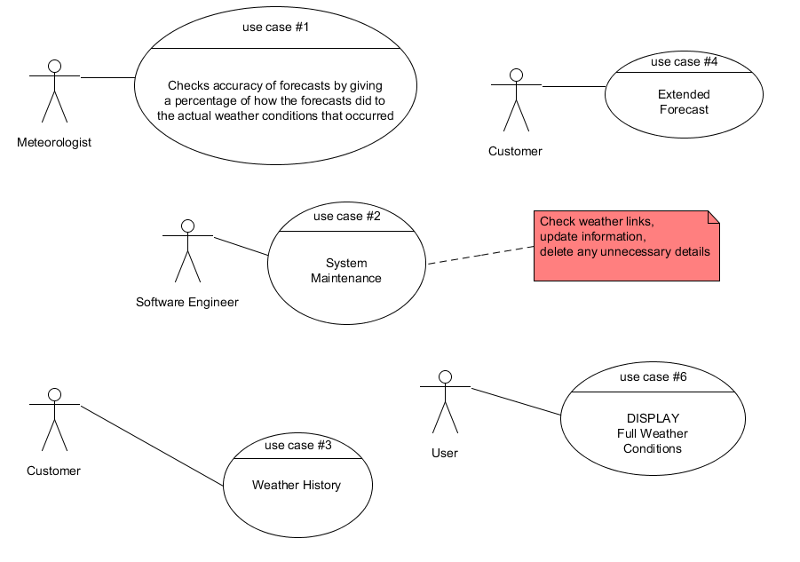
Usecase Diagrams

Slide 7
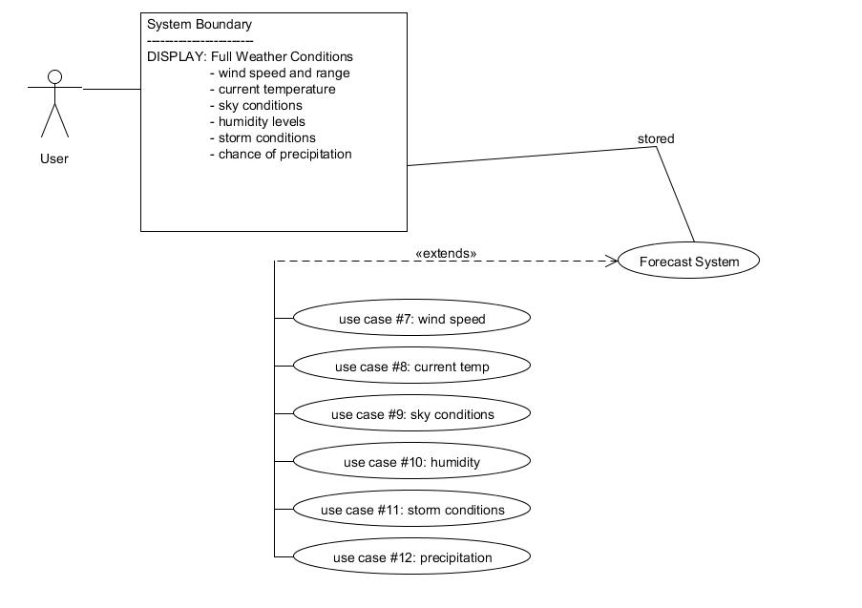
Usecase Diagrams

Slide 8
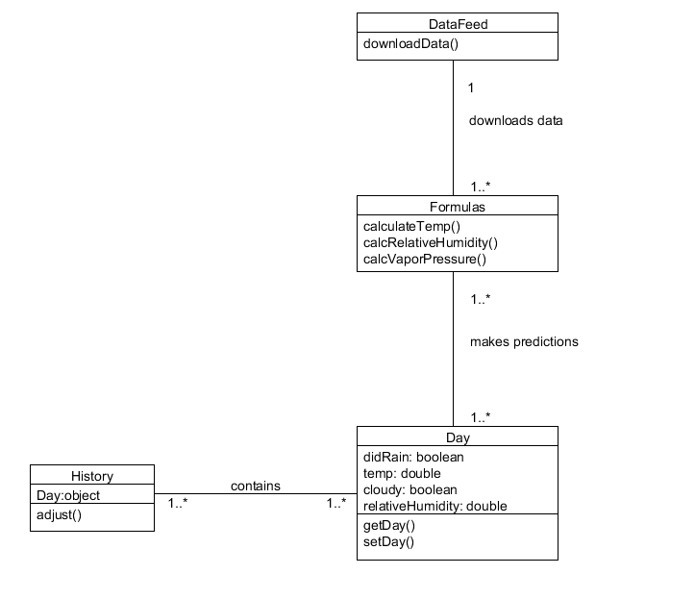
Class Diagram

Slide 9
Activity Diagram

Slide 10
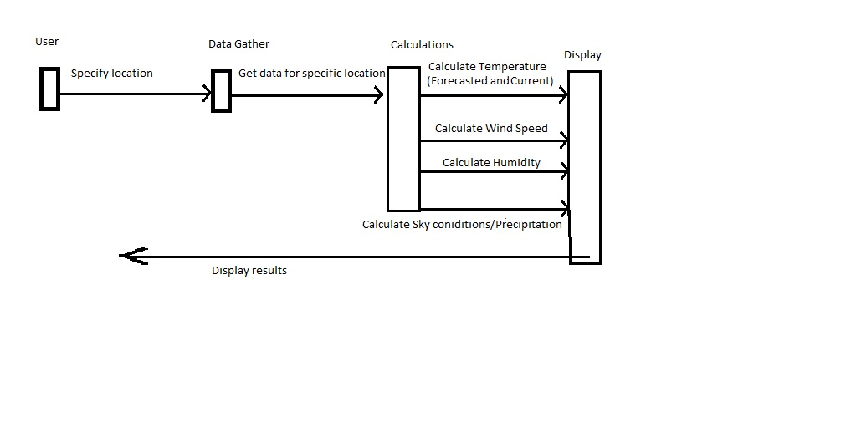
Sequence

Slide 11
Current Status
Completed all the initial documentation work for the project.
Started the coding work to collect all the required data from an online repository at Iowa State http://www.meteor.iastate.edu/~ckarsten/bufkit/data/

Slide 12
Project Schedule

Slide 13
Who’s Who
Name | Title | Contact information
Robert Niesen | Engineer Manager | rbniesen@gmail.com
Emmanuel Raguay | Project Manager | E-Raguay@neiu.edu
Lalitha Vedula | Programmer | n-vedula@neiu.edu
Dilusha Harischandra | Programmer | d-harischandra@neiu.edu
Ulloa Efren | Programmer | e-ulloa@neiu.edu
Notes:
Keep it brief. Make your text as brief as possible to maintain a larger font size.

Slide 14
Summary
Define our challenges
Technological
Learning Git
Deciding on a tool for the GUI interface
Deciding on which weather factors are more important to add into the forecast
Personal
Deciding on the proper procedure to ensure any code isn’t overwritten and corrupted
Notes:
Summarize presentation content by restating the important points from the lessons.
What do you want the audience to remember when they leave your presentation?
Save your presentation to a video for easy distribution (To create a video, click the File tab, and then click Share. Under File Types, click Create a Video.)

